Slide 1
Take-Home Lab #02
CS1020 – Data Structures And Algorithms 1
AY2016-17 Semester 2

Slide 2
Some UML notations…
className
attributeName : Type
methodName(input) : returnType
Signs
+ : public
- : private
~ : package-level (default)
# : protected
Notes:
2

Slide 3
Problem 1
File
Notes:
The discussion on this section focuses more on what do you need to solve OOP-related problems in general (i.e. how to get objects, store them, etc.)

Slide 4
Simulate a file manager system:
Create files and folders
Delete a file from a folder
Move a file to another folder
Calculate the size of a folder
Find the folder with the largest size
File

Slide 5
File Manager
Folder
File
File

Slide 6
File Manager
Tutorials
filenameOne
tournament
Take-Home
Labs
file
Sit-In
Labs
restaurant
File

Slide 7
File Manager
Folder
File
File

Slide 8
FileManager: public class FileManager()
Folder: class Folder(String name)
File: class File(String name, int fileSize, String folderName)
File

Slide 9
FileManager
Keeps a list of all folders currently in the system
Reads and executes the queries
Folder
File
Some tips:
Have a method to get the size of the folder.
Instead of having a setter to set the list of files, create an “addFile” method that acts as a “setter” of a file being added to the folder.
Whenever you add a file to a folder, change the folderName attribute of that file
Contains information about:
The file name
The file size
The folder in which the file is in
File

Slide 10
Folder
public void addFile(File newFile) {
this.listOfFiles.add(newFile);
newFile.setFolderName(this.getName());
}
public int getSize() {
int size = 0;
for (File f : listOfFiles) {
//read as: for every File f in listOfFiles
size += f.getSize();
}
return size;
}
File

Slide 11
FileManager
?
How do I get the Folder (or File) object, given its name?
VS
ArrayList
HashMap
Need to iterate through the list.
Elaborated further in the Restaurant problem discussion
Fast and Easy
File

Slide 12
FileManager
How do I use HashMap?
HashMap<Key, Value> hashMapName = new HashMap<Key, Value>();
HashMap
public class FileManager {
private HashMap<String, File> fileMapping;
private HashMap<String, Folder> folderMapping;
private ArrayList<Folder> listOfFolders;
public FileManager() {
this.fileMapping = new HashMap<String, File>();
this.folderMapping = new HashMap<String, Folder>();
this.listOfFolders = new ArrayList<Folder>();
}
… //etc.
}
File

Slide 13
Adding a Key-Value Mapping
folderMapping.put(folderName, newFolder);
folderName is a String while newFolder is a Folder
Value Retrieval using a Key
Folder retrievedFolder = folderMapping.get(folderName);
folderName is a string containing the name of the folder retrievedFolder
https://docs.oracle.com/javase/8/docs/api/java/util/HashMap.html

Slide 14
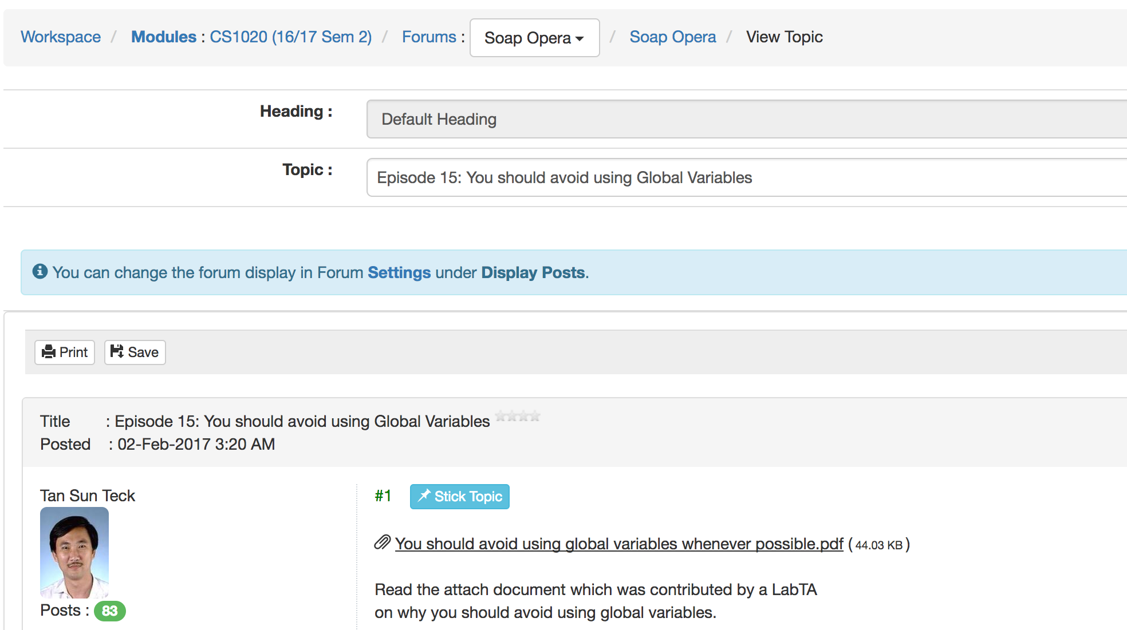
Problem 2
Forum
Notes:
The discussion on this section focuses more on what do you need to solve OOP-related problems in general (i.e. how to get objects, store them, etc.)

Slide 15
Develop a forum and perform the following queries:
User can post a message to a thread
Count the number of posts across some threads
Count the number of posts by a user
Print the user with the most posts in a certain thread
Print the content with a certain post number in a thread
Problem Description
Notes:
15

Slide 16
Forum
Thread
Post
User
Thread
Thread
Post
Thread
Problem Illustration
Notes:
A thread can have 0 or more posts
A post must belong to a thread, a post must be created by a user
16

Slide 17
Forum
contains
contains
Thread
contains
Post
creates
User
Relationship Between Entities
Notes:
17

Slide 18
Class Forum
Class User
Forum
Post
threadList : ArrayList<Thread>
userList : ArrayList<User>
username : String
noOfPost : int
+ //methods
+ getUsername() : String
+ getPostNo() : int
+ setPostNo(int) : void
…
Class Thread
Thread
Class Post
threadName : String
noOfPost : int
postList : ArrayList<Post>
Post
postNo : int
username : String
Message : String
+ getThreadName () : String
+ getNoOfPost() : int
+ getPostList() : ArrayList<Post>
# addPost(…) : void
…
+ getUsername() : String
+ getMessage() : int
…
Class Overview
Notes:
- refers to private
+ refers to public
# refers to protected
Methods are not mandatory, might change depending on each person’s implementation.
Not necessary to create getter/setter for every variable, create them only if required
18

Slide 19
Forum: public class Forum()
Thread: class Thread(String threadName)
Post: class Post(int postNo, User user, String message)
User: class User(String username)
Constructors

Slide 20
Some tips for processing the queries:
Perform all logical operations in the Forum class
The methods in the Thread, Post and User class are only for operations that modify or return their own attributes.
Avoid the use of static variables and methods
We define helper methods in Forum as we go along, e.g:
findThread(String threadName): returns the Thread with the name threadName, returns null if not found
count(Scanner sc): reads in a list of threadName, count the total number of post in total, and print the totalCount.
Useful Tips
Notes:
Static variables == minus marks D:
!!!
20

Slide 21
In the Forum Class
What some of you did:
public static void main(String[] args) {
//your code
}
public static Thread findThread(String threadName) {
//implementation
}
How to avoid static:
public static void main(String[] args) {
Forum myForum = new Forum();
myForum.run();
}
public void run() {
//your code (treat this as “main”)
}
public Thread findThread(String threadName) {
//implementation
}
How to avoid static
Notes:
21

Slide 22
public void run() {
Scanner sc = new Scanner(System.in);
int noOfUser = sc.nextInt();
readAndStoreUsers(sc, noOfUser);
int noOfThread = sc.nextInt();
readAndStoreThreads(sc, noOfThread);
int noOfQuery = sc.nextInt();
executeQueries(sc, noOfQuery);
}
The Run Method (in Forum)
Notes:
22

Slide 23
private void executeQueries(Scanner sc, int Q) {
int query = sc.nextInt();
for (int i = 0; i < query; i++) {
String type = sc.next();
switch (type) {
case "post":
forum.createPost(sc);
break;
case "count":
forum.countPost(sc);
break;
case "numpost":
forum.getNumPost(sc);
break;
// ...
}
}
}
Execute Queries
Notes:
Remember to use break when using switch-case
Also possible to implement using if-else :D
23

Slide 24
Query 1
private void createPost(Scanner sc) {
String threadName = sc.next();
String username = sc.next();
String message = sc.nextLine().trim();
// check for valid thread → print “no such thread”
Thread thread = findThread(threadName);
if (thread == null) {
System.out.println("no such thread");
return;
}
// check for valid user → print “no such user”
// ...
// creates new post
thread.addPost(user, message); // add post to thread
user.setPostNo(user.getPostNo()+1); // increment post count
System.out.println(message);
}
Query 1: Post a message to a thread
Notes:
sc.nextLine() takes in the whole line, including the carriage return, hence we need to use trim() to remove the carriage return
Remember to use return to terminate the method if the thread or user is not found, so that it will not continue to execute! It will hit an error if it reaches the creating of new post
24

Slide 25
Inside the Thread class
protected void addPost(User user, String message) {
Post newPost = new Post(++noOfPost,
user.getUsername(), message);
postList.add(newPost);
}
addPost method
Notes:
For methods that modifies or returns their own attributes, we put them in the respective own class, in this case, the Thread class :D
25

Slide 26
Helper Method (Reusable for queries 1, 2, 4 and 5)
/*
* pre-condition: The arraylist of threads has been initialized and threads
* have been stored properly
*
* post-condition: Returns the thread with name threadName and null if
* there is no such table
*
* description: iterates through the list of threads and return the most
* appropriate thread based on threadName. Returns null if no such thread
* is found
*/
private Thread findThread(String threadName) {
}
Loop through the list of threads
If the current thread’s name matches threadName, return that Thread and stop the loop.
After finish iterating and no thread is found: return null
Helper Method: findThread
Notes:
We don’t use a HashMap which maps threadName to Thread since HashMap has not been taught to the students yet.
Please do the same for findUser method :D
26

Slide 27
Query 2
private void countPost(Scanner sc) {
int noOfThread = sc.nextInt();
int count = 0;
for (int i = 0; i < noOfThread; i++) {
String threadName = sc.next();
// Get the thread based on the threadName
Thread thread = findThread(threadName);
// Get the number of post in the thread
count += thread.getNoOfPost();
}
System.out.println(count);
}
Query 2: Number of posts across some threads
Notes:
27

Slide 28
Query 3
private void getNumPost(Scanner sc) {
String username = sc.next();
// check for valid user → print “no such user”
// ...
System.out.println(user.getPostNo());
}
postNo of user is constantly updated in each createPost() methods, so get only need to call getPostNo()
Query 3: Number of posts by a user
Notes:
28

Slide 29
Query 4
private void getMaxPost(Scanner sc) {
String threadName = sc.next();
// check for valid thread → print “no such thread”
ArrayList<String> userList = new ArrayList<String>();
ArrayList<Integer> countList = new ArrayList<Integer>();
// Loop through posts, increment countList accordingly
// index 0 of userList correspond to index 0 of countList
ArrayList<String> noLifeUserList = new ArrayList<String>();
// Loop through countList to find the highest count
// Retrieve the corresponding user/s
Collections.sort(noLifeUserList);
System.out.println(noLifeUserList.get(0));
}
Query 4 : User with the most posts in a thread
Notes:
Collections.sort automatically sorts the ArrayList in ascending order, with the lexicographically smallest element first
29

Slide 30
Query 5
private void getContent(Scanner sc) {
String threadName = sc.next();
int postNo = sc.nextInt();
Thread thread = findThread(threadName);
// check for valid thread → print “no such thread”
Post post = thread.getPost(postNo);
// check for valid post → print “no such post”
System.out.println(post.getMessage());
}
Query 5 : Print the content with a post number
Notes:
30

Slide 31
Inside the Thread class
protected Post getPost(int postNo) {
// check for valid postNo
if (postNo <= postList.size()) {
return postList.get(postNo-1);
} else {
return null;
}
}
getPost method
Notes:
For methods that modifies or returns their own attributes, we put them in the respective own class, in this case, the Thread class :D
31

Slide 32
Problem 3
Storage
Notes:
The discussion on this section focuses more on what do you need to solve OOP-related problems in general (i.e. how to get objects, store them, etc.)

Slide 33
Simulate an inventory manager :
Set up 1 hand (size S) and N boxes (size K)
Purchase items (name, value) into
Hand (when hand is not full)
Boxes (when hand is full)
Deposit an item (by name) from hand to a box
Withdraw an item (by name) a box to hand
Locate an item (by name)
In hand or in box[i]
Find the item (by name) with the greatest value
Storage

Slide 34


Inventory Manager
Item A1
Value x1
Item A2
Value x2
Item A3
Value x3
…
Item A4
Value x4
Item A5
Value x5
Item A6
Value x6
Item A7
Value x7
…
#1
Item A8
Value x8
Item A9
Value x9
…
#2
…
Storage

Slide 35

Inventory Manager
Hand
capacity | : int
itemNameList | : ArrayList<String>
Box
number | : int
capacity | : int
itemNameList | : ArrayList<String>
Item
name | : String
value | : int
location | : int
Storage

Slide 36
StorageManager: class StorageManager(int N, int S, int K, int Q)
Hand: class Hand(int capacity, ArrayList<Item> itemList)
Box: class Box(int number, int capacity, ArrayList<Item> itemList)
Item: class Item(String name, int value)
Storage

Slide 37
StorageManager
Manage hand, boxes and the list of all items
Provide methods for query transactions:
purchase, deposit, withdraw, …
Hand/Box
Item
Provide basic operations that add or remove file name from the list
These basic operations are supposed to be called by query methods implemented in StorageManager
Other helper methods, like isFull, isEmpty, etc…
Provide setter and getter for:
name
value
location
0 indicate the location for hand
Storage

Slide 38
An example: withdraw
Hand/Box
public boolean add(String itemName) {
return this.itemList.add(newFile);
}
public boolean remove(String itemName) {
return this.itemList.remove(itemName);
}
public boolean isFull() {
return itemNameList.size()>=this.capacity;
}
Storage

Slide 39
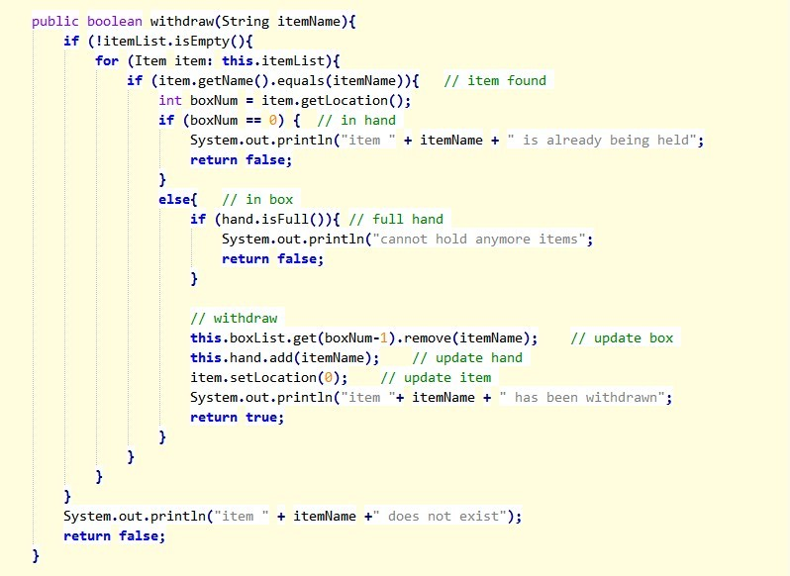
StorageManager
Storage

Slide 40
StorageManager
?
How do I get the item object, given its name?
VS
ArrayList
HashMap
Need to iterate through the list
Fast and Easy
Storage

Slide 41
StorgeManager
How do I use HashMap?
HashMap<Key, Value> hashMapName
= new HashMap<Key, Value>();
HashMap
public class StorageManager {
private HashMap<String, Item> itemMap; // HashMap
private Hand hand;
private ArrayList<Box> boxList;
…
public FileManager() {
this.itemMap = new HashMap<String, Item>();
…
}
…
}
Storage

Slide 42
Adding a Key-Value Mapping
newItem = new Item(itemName, itemValue);
itemMap.put(itemName, newItem);
itemName is a String while newItem is an Item
Value Retrieval using a Key
Item retrievedItem = itemMap.get(itemName);
retrievedItem is an item in the itemMap,
whose name is itemName
https://docs.oracle.com/javase/8/docs/api/java/util/HashMap.html

Slide 43
End Of File
Any Questions?

